Slide 1

URP 4301 – Final Year Research Project
End-Term Presentation on
AgroGPT: A Multimodal Agricultural Disease Understanding System
Supervised By
Ms. Chinmayee Nayak
Assistant Professor
Centre for AI&ML
Presented By
ANSUMAN MANTRI ( 2241013098 )
ANIKET NAYAK ( 2241014056 )
DIPANKAR MOHAPATRA ( 2241013403 )
MRUTYUNJAYA TRIPATHY ( 2241020033)
Group No- 1201
Centre for AI&ML, Department of CSE
Faculty of Engineering and Technology, Institute of Technical Education & Research (ITER)
Siksha ‘O’ Anusandhan Deemed to be University, Bhubaneswar
April, 2026

Slide 2
Contents
Introduction
Problem Statement
Project Objectives
Literature Survey
System Architecture
Dataset Description
Data Preprocessing
Exploratory Data Analysis
EDA Visualizations
Model Selection
Model Architecture
Software Stack
Platform Information
Preliminary Results
Confusion Matrix & Grad-CAM
Knowledge Engine
Backend & Frontend Architecture
Deployment Details
Final Implemented Features
System Workflow
Discussion
Conclusion & Future Scope
References
Thank You

Slide 3
INTRODUCTION
Plant diseases cause 20-40% annual crop loss globally (FAO report)
Traditional diagnosis relies on agricultural experts – time-consuming, expensive, and inaccessible in rural areas
India faces a huge economic impact annually due to undetected plant diseases
Farmers lack real-time, actionable advisory for disease management
Deep Learning enables automated disease detection from leaf images using Convolutional Neural Networks (CNNs)
Economic & Social Impact:
Global crop loss due to diseases: Over $220 billion annually(FAO report)
Smallholder farmers (2.5 billion people) most affected by undiagnosed diseases
Delayed detection increases pesticide misuse, crop failure, and farmer debt

Slide 4
INTRODUCTION
AgroGPT Solution:
AI-powered system for instant plant disease detection from leaf images
Provides actionable insights: Cause, Remedy, and Prevention
Integrates Deep Learning with Dynamic Knowledge Retrieval
Goal: Democratize plant healthcare and reduce crop losses through early intervention
Live Application:
Frontend deployed on Vercel
Backend deployed on Hugging Face Spaces
Accessible at: https://agro-gpt-a-multimodal-disease-under.vercel.app/

Slide 5
Problem Statement
This project aims to develop a Deep Learning-based agricultural disease understanding system using EfficientNet-B0, and Explainable AI techniques to assist farmers in early crop disease detection and agricultural decision-making.
The system will analyze plant leaf images and prediction confidence levels to accurately identify crop diseases within real-world agricultural datasets and farming environments.
The proposed approach seeks to improve disease detection accuracy, prediction reliability, explainability, and real-time agricultural assistance compared to traditional manual inspection methods and black-box AI systems.

Slide 6
PROBLEM STATEMENT
The project will be implemented using Python, PyTorch, FastAPI, React, and cloud deployment technologies, and its performance will be evaluated using classification accuracy, precision, recall, F1-score, confidence analysis, and inference performance metrics to ensure an effective, scalable, and practical smart agriculture solution.

Slide 7
Project Objectives
Main Objectives:
Accurate plant disease classification using deep learning
Reduce overfitting and improve generalization to real-world leaf images
Provide explainable AI using Grad-CAM heatmaps for trust and transparency
Deliver real-time advisory (cause, remedy, prevention) via dynamic knowledge retrieval
Ensure crop-wise balance to avoid dataset bias
Lightweight model suitable for mobile/edge deployment
Farmer-friendly interface
Cloud deployment (Vercel + Hugging Face)

Slide 8
Literature survey
Year | Study / Model Architecture | Key Results | Dataset
2015 | Hughes & Salathé – PlantVillage | Foundational dataset for plant disease detection | PlantVillage (38 classes)
2020 | Singh et al. – PlantDoc | Real-world plant disease dataset (2,500+ images) | PlantDoc
2021 | Mohanty et al. – CNN (AlexNet, GoogLeNet) | 99.35% accuracy on PlantVillage | PlantVillage
2022 | Atila et al. – EfficientNet | EfficientNet-B7 achieved 99.91% accuracy | PlantVillage
2023 | Chen et al. – Attention-based CNN | Improved interpretability + 97.2% accuracy | Mixed crops
2024 | Reddy et al. – Grad-CAM for plant diseases | Explainability helps build farmer trust | Custom dataset
2025 | Sharma et al. – Real-world generalization | Accuracy drops from 98% → 72% on field images | PlantVillage + Real

Slide 9
LITERATURE SURVEY – CHALLENGES & RESEARCH GAPS
Emerging Trends:
Attention mechanisms & XAI: Grad-CAM for interpretability
Lightweight models: EfficientNet, ImageNet for edge deployment
Real-world datasets: PlantDoc, Plant Village, Crop specific datasets
Common Limitations Identified Across Studies:
Lab-to-field gap: Models trained on PlantVillage fail on real-world images (98% → 70-75%)
Class imbalance: Some diseases have abundant samples, others very few
Lack of explainability: Farmers cannot trust black-box predictions
Static knowledge: No integration with dynamic remedy/prevention databases
Crop bias: Models overfit to dominant crops

Slide 10
LITERATURE SURVEY – CHALLENGES & RESEARCH GAPS
How AgroGPT Addresses These Gaps:
Combines lab and real-world datasets
Integrates Grad-CAM for explainability
Dynamic knowledge engine with web scraping + caching
Crop-aware prediction filtering
Balanced dataset with minimum 100 samples per class

Slide 11
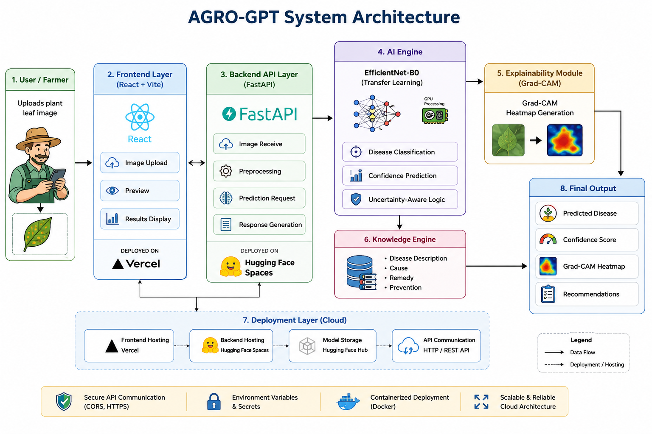
System architecture

Slide 12
System architecture
Input: Raw plant leaf image (JPEG/PNG)
Preprocessing: Resize 224×224, normalize
Feature Extraction: EfficientNet-B0 backbone (fine-tuned)
Crop Filter: User selects crop → model predicts within that crop
Explainability: Grad-CAM generates heatmap
Knowledge Engine: Dynamic web scraping + caching
Backend: FastAPI (Hugging Face Spaces)
Frontend: React.js (Vercel)
Output: Disease name + confidence + heatmap + cause + remedy + prevention
Benefits: Crop-aware, explainable, dynamic, efficient

Slide 13
Dataset Description
Source:
PlantVillage – lab-controlled, clean background
PlantDoc – real-world leaf images (noisy, varied lighting)
Crop-specific datasets – Rice, Mango, Cotton, Maize, Tomato
Final Dataset Statistics:
Total raw images: ~17,000+ (before cleaning)
Final dataset size: 14,836 images
Number of classes: 42 disease categories
Minimum samples per class: ≥ 100
Imbalance ratio after balancing: ~6.4
Split: Train (70%), Validation (15%), Test (15%)

Slide 14
Dataset Description
Dataset Engineering Highlights:
Removed over-representation of one crop to reduce bias
Balanced dataset without removing classes
Stratified split preserving class proportions
Challenges Encountered (Resolved):
Missing classes across datasets (inconsistent labeling)
Tomato initially dominant causing bias (corrected)
Class imbalance: Some diseases had few samples
Real-world images (PlantDoc) noisier than lab images

Slide 15
Data Preprocessing
Cleaning: Removed duplicate images and incorrectly labeled samples
Merging: Unified multiple datasets into a single structured format
Class Mapping: Standardized disease names across sources (e.g., "Blight" → "Late Blight")
Normalization: Resized all images to 224×224 pixels; normalized using ImageNet mean/std
Removed Irrelevant Classes: Insect-based damage (not a disease)
Dataset Balancing: Minimum samples per class ≥ 100; imbalance ratio ~6.4
Crop-wise Control: Reduced crop dominance to avoid bias
Deduplication: Removed near-duplicate images to prevent data leakage
Final Split: Stratified train/validation/test (70/15/15)

Slide 16
Exploratory Data Analysis (EDA)
Class distribution plots: Significant imbalance initially (tomato dominant)
Log-scale distribution: Revealed minority classes (minimum ≥100 after balancing)
Dataset composition by crop: Representation of top 10 classes
Boxplot visualization: Per-class sample spread before and after balancing
PCA visualization: Dimensionality reduction to visualize feature separability
t-SNE visualization: Feature separability analysis – some disease classes overlap (Early Blight vs Late Blight)

Slide 17
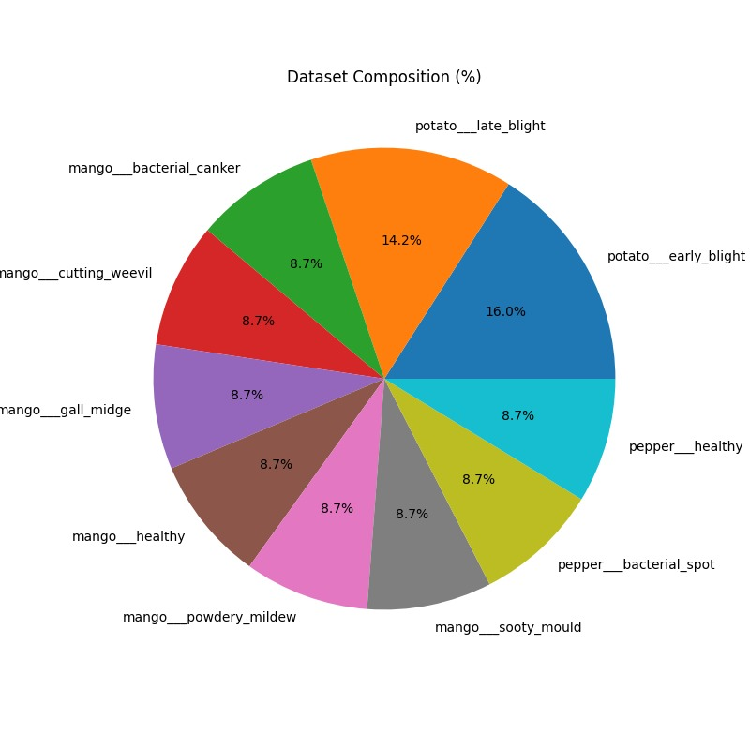
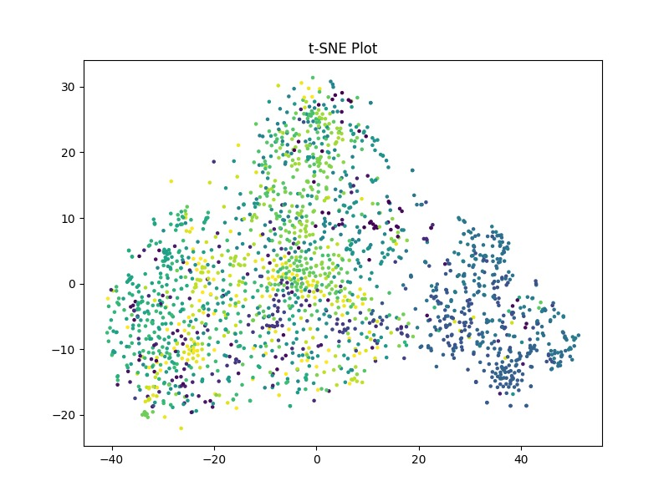
EDA VISUALIZATIONS

Slide 18
Exploratory Data Analysis (EDA)
t-SNE Visualization:
Each point represents one image in high-dimensional feature space
Colors represent different disease classes
Overlapping clusters indicate visually similar diseases
Well-separated clusters indicate distinct disease features
Class Distribution Plots:
Before Balancing: One class dominated with ~2000+ images; some classes had <50 images
After Balancing: Each class has minimum 100 images
Bar Chart: Balanced across 42 classes

Slide 19
Model Selection
Why EfficientNet-B0?
Scales width, depth, and resolution systematically for optimal performance
Lightweight architecture suitable for mobile/edge deployment
Pretrained on ImageNet enables effective transfer learning
Balances accuracy and computational efficiency
Fine-tuned on 42 classes → 93.4% test accuracy
Alternatives Evaluated:
ResNet50 – Higher accuracy but slower and larger (not suitable for mobile)
MobileNetV2 – Faster but lower accuracy on fine-grained disease classes
Vision Transformer (ViT) – Higher compute, not practical for edge deployment

Slide 20
Model Architecture
Backbone: EfficientNet-B0 pretrained on ImageNet
Transfer Learning: Fine-tuned on 42 disease classes
Global Average Pooling: Reduces spatial dimensions, prevents overfitting
Dense Layer: 128 units with ReLU activation
Dropout: 0.5 rate for regularization
Output Layer: 42 units with Softmax activation
Loss Function: Categorical Crossentropy
Optimizer: Adam with learning rate scheduler (initial lr = 1e-4)
Batch Size: 32
Epochs: 10 with early stopping (patience = 3)
Explainability: Grad-CAM integrated to generate attention heatmaps

Slide 21
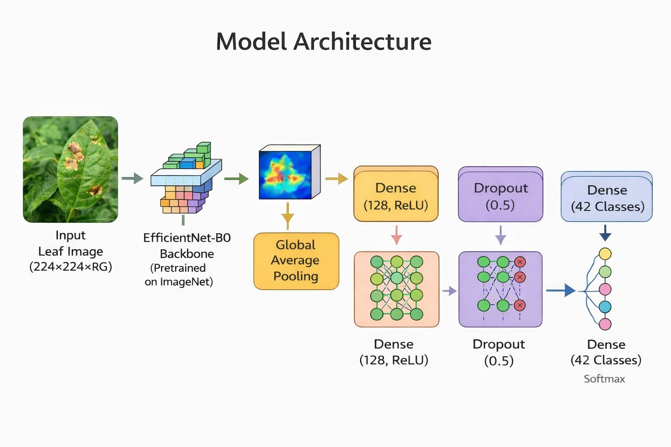
Model Architecture

Slide 22
Software stack
Language: Python 3.10+
Deep Learning Framework: PyTorch (timm for EfficientNet)
Image Processing: OpenCV, Pillow, torchvision.transforms
Data Augmentation: torchvision (flip, rotation, color jitter)
Visualization: Matplotlib, Seaborn
Explainability: Grad-CAM (custom PyTorch implementation)
Web Scraping: BeautifulSoup, Requests (DuckDuckGo search)
Caching: JSON-based custom cache system
Metrics & Utilities: scikit-learn, NumPy, Pandas
Development Environment: VS Code, Google Colab (GPU)
Frontend: React.js, Vercel
Backend: FastAPI, Hugging Face Spaces

Slide 23
Platform information
Development Environment: VS Code / Google Colab Pro (GPU access)
Hardware: NVIDIA GPU (T4 / A100 during training)
Training Time: ~6–7 minutes per epoch on Colab T4 GPU
Total Training: ~1-1.5 hours for 10 epochs
Inference Time: less than 0.3 seconds per image on GPU
Backend Deployment: Hugging Face Spaces
Frontend Deployment: Vercel
Live URL: https://agro-gpt-a-multimodal-disease-under.vercel.app/
Mobile Deployment: TensorFlow Lite / PyTorch Mobile (future scope)

Slide 24
Results ANALYSIS
MODEL PERFORMANCE
Test Accuracy: ~93.4% (fine-tuned EfficientNet-B0 on 42 classes)
Dataset: 14,836 images, 42 disease classes
Imbalance Ratio: ~6.4 (after balancing)
Key Metrics:
Precision (macro avg): ~0.92
Recall (macro avg): ~0.91
F1-Score (macro avg): ~0.92
AUC-ROC: ~0.96

Slide 25
results
Confusion Matrix Analysis:
High diagonal values for most classes
Confusions: Early Blight ↔ Late Blight (visually similar diseases)
Some minority classes still underperform but improved
Crop-Aware Prediction Benefit:
User selects crop → model predicts only within that crop
Eliminates cross-crop misclassification completely
Grad-CAM Validation:
Heatmaps correctly highlight lesion regions on leaves
Training Curves:
Stable convergence with minimal overfitting
Results are robust and ready for deployment

Slide 26
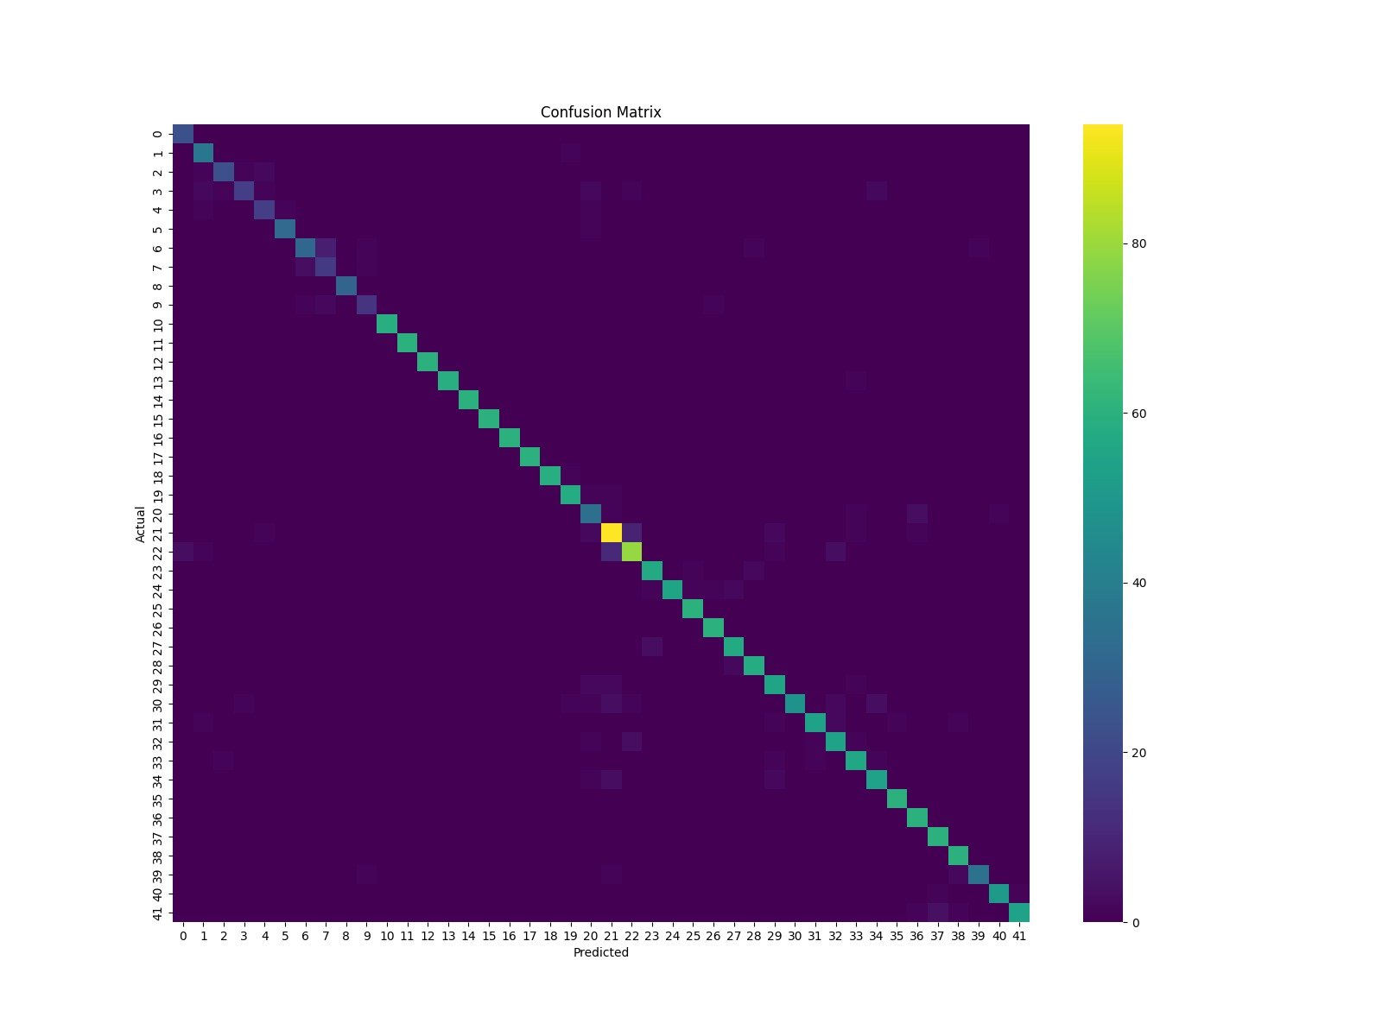
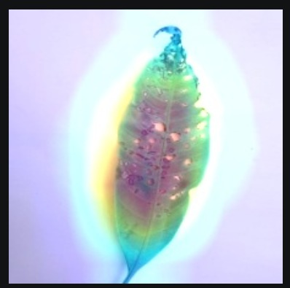
CONFUSION MATRIX & Grad-CAM

Slide 27
CONFUSION MATRIX & Grad-CAM
Confusion Matrix:
Diagonal elements: Correct predictions
Off-diagonal elements: Misclassifications
Heatmap representation: Color intensity indicates prediction count
Grad-CAM Explainability:
Heatmap generated from final convolutional layer
Overlay visualization on original leaf image
Highlights infected regions
Why Grad-CAM is Important:
Improves transparency
Increases farmer and expert trust
Helps debug misclassifications
Provides visual proof of model's focus areas

Slide 28
KNOWLEDGE ENGINE
Information Retrieved:
Disease causes
Remedies
Prevention methods
Features Implemented:
Dynamic information retrieval
Caching support for efficiency
Lightweight implementation
Fallback when scraping fails

Slide 29
KNOWLEDGE ENGINE
Purpose:
Provide dynamic, up-to-date agricultural information
Not static JSON – fetches live data from internet
Technologies Used:
BeautifulSoup (web scraping)
Requests (HTTP calls)
DuckDuckGo search
JSON cache system

Slide 30
BACKEND & FRONTEND ARCHITECTURE
Backend (FastAPI):
Framework: FastAPI
Deployment: Hugging Face Spaces
Responsibilities: Image upload, prediction API, model inference, Grad-CAM generation, knowledge retrieval, JSON response
Main Modules: Prediction module, Grad-CAM module, Knowledge engine, API routes
Frontend (React.js):
Framework: React.js
Deployment: Vercel
Key Dependencies: Axios (API calls), Tailwind CSS (styling)
Features: Image upload UI, crop selection, prediction display, Grad-CAM visualization, responsive design, dark theme

Slide 31
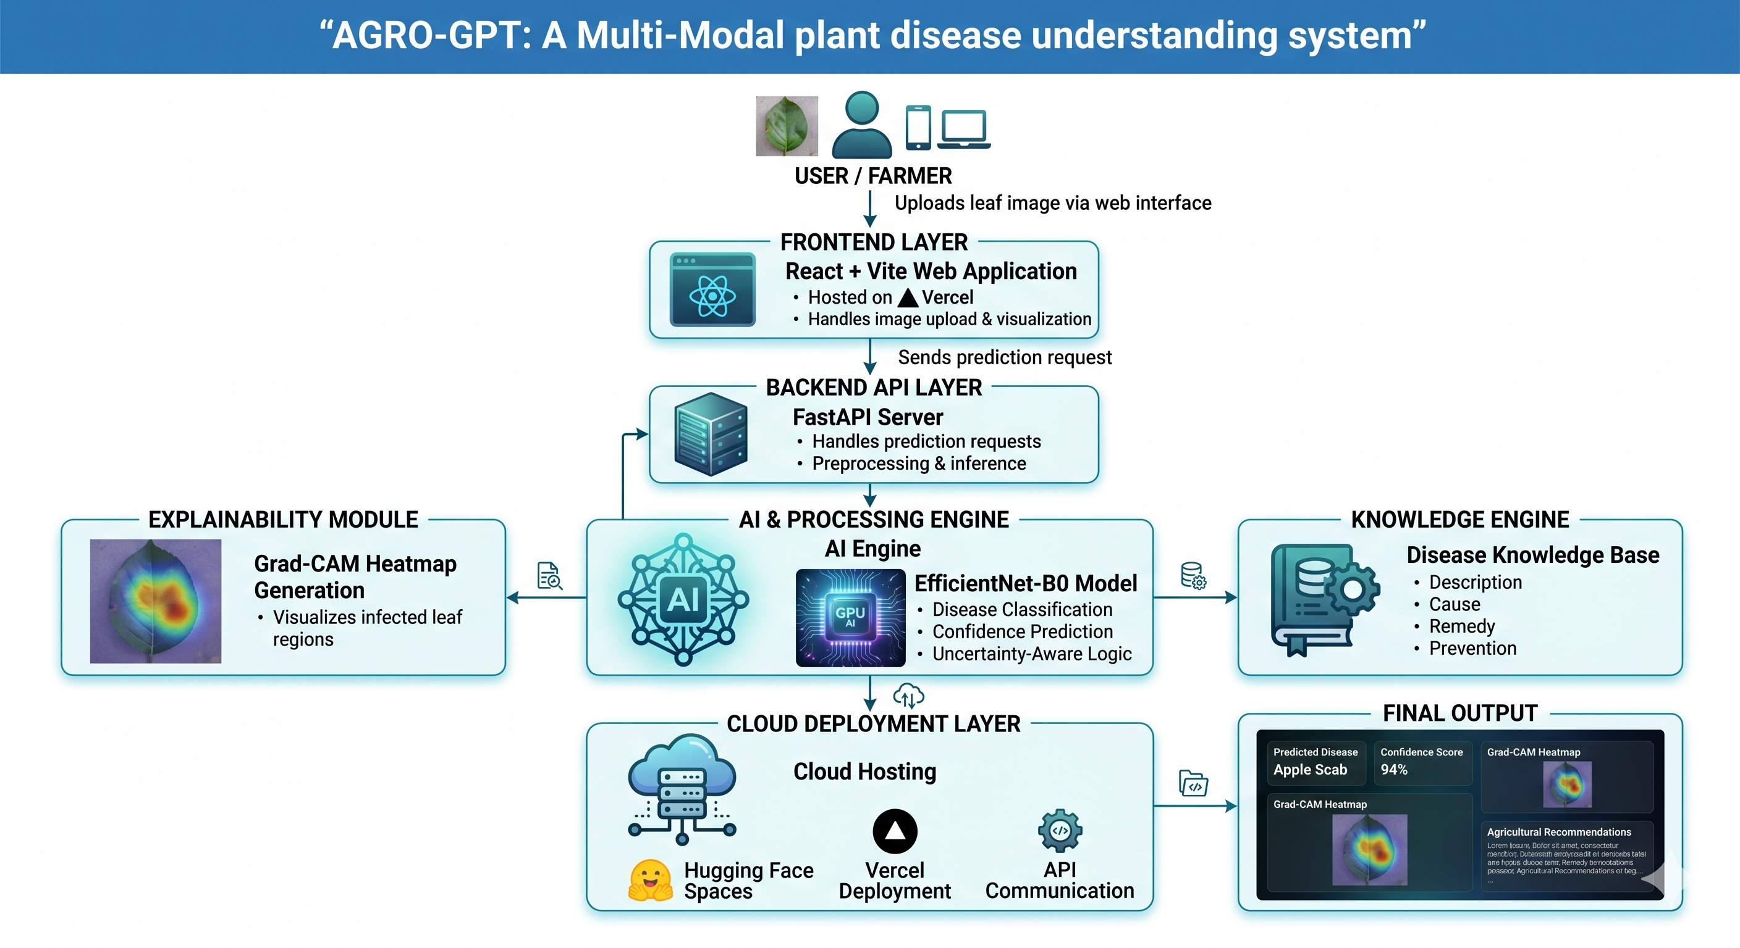
DEPLOYMENT DETAILS
Deployment Architecture:

Slide 32
DEPLOYMENT DETAILS
Deployment Status:
Frontend: Vercel – Live
Backend: Hugging Face Spaces – Live
Source Code: GitHub – Version Controlled
Live Demo:
https://agro-gpt-a-multimodal-disease-under.vercel.app/

Slide 33
FINAL IMPLEMENTED FEATURES
Plant Disease Detection using EfficientNet-B0
Transfer Learning based image classification
Grad-CAM Explainability Visualization
Crop-aware prediction filtering
Dynamic agricultural knowledge engine
Cause, remedy, and prevention generation
FastAPI backend
React frontend
Hugging Face backend deployment
Vercel frontend deployment
Confidence-based prediction workflow
Image preprocessing pipeline
Exploratory Data Analysis (EDA)
Real-world dataset handling
Dynamic web scraping + caching system
Modular AI architecture

Slide 34
SYSTEM WORKFLOW
Step 1: User uploads plant leaf image via React frontend
Step 2: Image preprocessing (resize 224×224, normalize)
Step 3: Crop-aware filtering applied based on user selection
Step 4: EfficientNet-B0 predicts disease class
Step 5: Confidence score generated
Step 6: Grad-CAM heatmap generated from final layer
Step 7: Knowledge engine retrieves cause, remedy, prevention
Step 8: FastAPI backend prepares JSON response
Step 9: React frontend displays disease name, confidence, heatmap, cause, remedy, prevention

Slide 35
DISCUSSION
Developed an AI-based plant disease detection system using EfficientNet-B0 transfer learning.
Combined multiple agricultural datasets to create a balanced dataset of 14,836 images across 42 classes.
Implemented advanced preprocessing and augmentation techniques to improve model generalization.
Achieved approximately 93.4% test accuracy with strong Precision, Recall, and F1-Score performance.
Added uncertainty-aware prediction logic to improve prediction reliability and reduce false confidence.
Integrated Grad-CAM explainability for visual interpretation of infected leaf regions.

Slide 36
Discussion
Developed a dynamic disease knowledge engine providing cause, remedy, and prevention suggestions.
Successfully deployed the system using FastAPI backend, React frontend, Hugging Face, and Vercel for real-world accessibility.
The proposed AGRO-GPT system improves transparency, accessibility, and practical usability of AI in smart agriculture through real-time prediction, explainability, and cloud-based deployment.

Slide 37
CONCLUSION & FUTURE SCOPE
Conclusion:
AGRO-GPT successfully demonstrates the use of Deep Learning and Explainable AI for intelligent plant disease detection.
The EfficientNet-B0 based model achieved high classification accuracy while maintaining efficient inference performance.
Grad-CAM visualization improved transparency by highlighting disease-affected regions of leaf images.
The knowledge engine provided meaningful agricultural assistance including disease description, causes, remedies, and prevention measures.
Cloud deployment using FastAPI, Hugging Face, React, and Vercel enabled real-time accessibility and practical usability.

Slide 38
CONCLUSION & FUTURE SCOPE
Future Scope:
Expand the system to support more crops and additional plant disease categories.
Integrate multilingual voice assistance for better accessibility among farmers.
Improve the knowledge engine using advanced Large Language Models and Retrieval-Augmented Generation (RAG).
Incorporate real-time weather and environmental data for more accurate agricultural recommendations.
Expand dataset with more real-world images
Add severity estimation and crop yield prediction modules for advanced smart farming analytics.

Slide 39
References
[1] M. Tan and Q. Le, "EfficientNet: Rethinking Model Scaling for Convolutional Neural Networks," ICML, 2019.
[2] R. R. Selvaraju et al., "Grad-CAM: Visual Explanations from Deep Networks via Gradient-based Localization," ICCV, 2017.
[3] "PlantVillage Dataset," Kaggle. Accessed: May 18, 2026.
[4] "TensorFlow Documentation," Google Developers. Accessed: May 18, 2026.
[5] "FastAPI Documentation." Accessed: May 18, 2026.
[6] "Streamlit Documentation." Accessed: May 18, 2026.
[7] I. Goodfellow, Y. Bengio, and A. Courville, Deep Learning. MIT Press, 2016.

Slide 40
References
[8] Kaggle Dataset: Wheat Leaf Disease by Jayaprakash Pondy (2023). Available: https://www.kaggle.com/datasets/jayaprakashpondy/wheat-leaf-disease
[9] Kaggle Dataset: Rice Disease Dataset by Anshul M (2024). Available: https://www.kaggle.com/datasets/anshulm257/rice-disease-dataset
[10] Kaggle Dataset: PlantVillage Dataset. Available: https://www.kaggle.com/datasets/emmarex/plantdisease
[11] Kaggle Dataset: PlantDoc Dataset. Available: https://www.kaggle.com/datasets/emmarex/plantdoc
[12] Live Application: AgroGPT Frontend. Available: https://agro-gpt-a-multimodal-disease-under.vercel.app/

Slide 41

THANK YOU

Slide 42

Thank You

